Slide 1

China’s IMT-2020 Submission
IMT-2020 Promotion Group
December 10, 2019

Slide 2





China Devotes to an IMT-2020 Ecosystem with
More Vitality, Long Life Cycle
IMT-2020
…
Spectrum
Global
Harmonization
Standard
Unification
Technology
Enabler
3

Slide 3
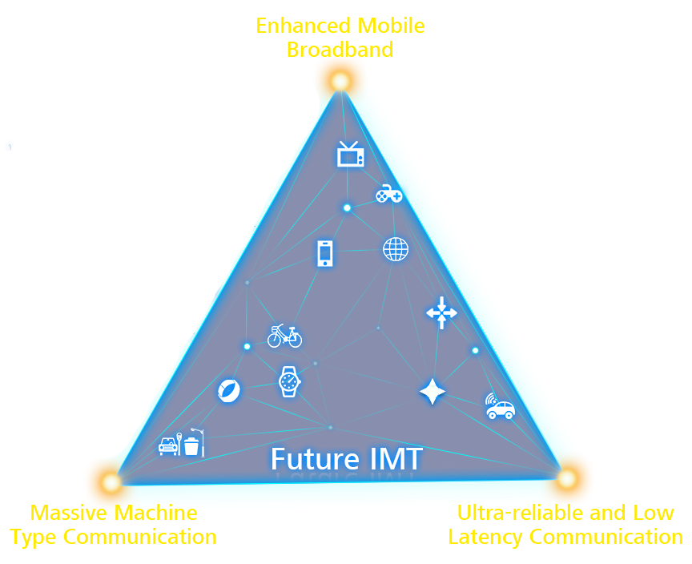
Full Capability for IMT-2020 Scenarios
eMBB
NR
China’s final IMT-2020 candidate technology is RIT, composed of NR and NB-IoT, which targets to fulfill all usage scenarios.
NR
NB-IoT
URLLC
NR
mMTC
All-Spectrum Access
For All scenario, All requirements
For Hotspot high data rate enhancement
0
6GHz
100GHz
5

Slide 4
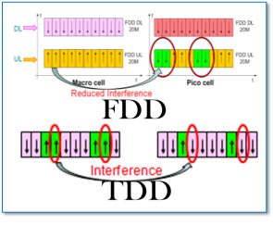
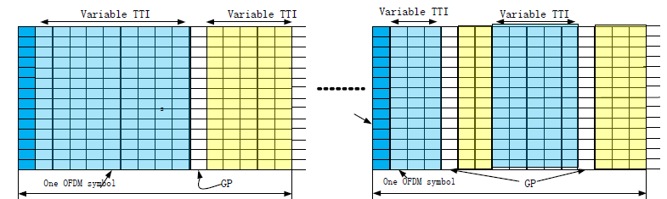
Key IMT-2020 Technologies
Flexible System Design
Innovative Tech. for NR
Tech. features for NB-IoT
Flexible Frame Structure with self-contained & variable length TTI
Flexible Waveform with forward compatibility
Flexible Duplex with Symmetric TX/RX Design
Advanced coding
Massive MIMO with Unified framework for control and data
Signaling & feedback enhancement
Beamforming enhancement
Large coverage
Massive connection
Low power consumption
Low cost
Polar
LDPC
15 kHz
3.75 kHz
180 kHz
×48
180 kHz
×12
…
…
15 kHz
3.75 kHz
Dense subcarrier spacing
NR
NR
Flexible in-band/out of band deployment
4

Slide 5
Self-evaluation for IMT-2020 Scenarios
NR
KPI | REQ. | EVAL RESULTS
Peak data rate (Gbit/s) | DL: 20; UL: 10 | ✓
Peak spectral efficiency (bit/s/Hz) | DL: 30; UL: 15 | ✓
User experienced data rate (Mbit/s) | DL: 100; UL: 50 | ✓
5th percentile user spectral efficiency (bit/s/Hz) | 3x IMT-A | ✓
Average spectral efficiency(bit/s/Hz/ TRxP) | 3x IMT-A | ✓
Area traffic capacity (Mbit/s/m²) | DL:10; UL: 10 | ✓
User plane latency (ms) | DL:4; UL:4 | ✓
Control plane latency (ms) | 20 | ✓
Mobility classes | 1.5x IMT-A, plus high speed vehicular requirement | ✓
eMBB
The self-evaluation results are contributed by a number of Chinese companies, who also contributed the same results to 3GPP.
NR
NB-IoT
NR
KPI | REQ. | EVAL RESULTS
Connection density (devices/km²) | 1 milion | ✓
mMTC
URLLC
KPI | REQ. | EVAL RESULTS
User plane latency (ms) | DL: 1; UL: 1 | ✓
Control plane latency (ms) | 20 | ✓
Reliability | 99.999% | ✓
5

Slide 6
China Supports Global Unified IMT-2020 Standard
China supports a globally unified IMT-2020 standard.
China actively contributes to 3GPP’s IMT-2020 (5G) development, and supports 3GPP technology as the globally unified IMT-2020 standard.
China’s submission included NR and NB-IoT, and is compliant with 3GPP R15 and R16 specifications, targeting to fulfill all usage scenarios.
3GPP Rel-15
3GPP Rel-16
2018.06
2019.12
6

Slide 7

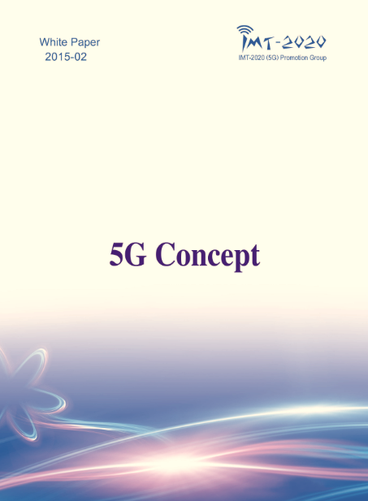
THANK YOU!
IMT-2020 (5G) Promotion Group is willing to strengthen international collaboration to promote globally unified 5G standardization and industrialization.
IMT-2020
www.imt-2020.cn

